Slide 1
Experiencing Transformation: the renewing of our mind
Progress through process
Rom 12:1-2, Prov 23:7
20/01/18

Slide 2
Key scriptures
Rom 12:1-2
I beseech you therefore, brethren, by the mercies of God, that you present your bodies a living sacrifice, holy, acceptable to God, which is your reasonable service.
And do not be conformed to this world, but be transformed by the renewing of your mind, that you may prove what is that good and acceptable and perfect will of God.
Prov 23:7a
“For as he thinks in his heart so is he…”
Notes:
We read and quote Rom 12: 1-2 over and over again. I want to focus this morning on v2 which is the second step to experiencing the power of a resurrected life. Step One: is presenting our bodies as a living sacrifice – that means every part of our body – including our minds. Step Two: is to allow ourselves to be transformed instead of conformed. We are transformed by the renewing of our mind.
Prov 23:7 tells us that the thoughts we think are important because it determines what we are and what we eventually become.

Slide 3
Phil 4:8
Finally, believers,
whatever is true,
whatever is honourable and
worthy of respect,
whatever is right and confirmed by God’s word,
whatever is pure and wholesome,
whatever is lovely and brings peace,
whatever is admirable and of good repute;
Notes:
The Living Bible translation says “Fix your thoughts on what is good and true and right”

Slide 4

Phil 4:8 cont’d
If there is any excellence,
If there is anything worthy of praise,
Think continually on these things
[centre your mind on them, and
implant them in your heart].
Amos 3:3
“Can two walk together unless they are agreed?”
Notes:
I need to centre my mind on these things and implant them into my heart
I need to agree with what God says about me. I need to agree with what God sees in me. I need to agree with His vision of success over my life.
My thoughts are very important.
We are covering a series on Guarding your mind with Pastor John Osteen. We heard that satan’s entrance point is through the mind. Have you ever seen a movie scene or a cartoon when it’s like the devil walks alongside a person and whispers to them and then the person does or says whatever the devil whispers. That’s exactly what happens. The entrance point is through the mind. I need to forsake my thoughts and accept God’s thoughts.
The devils comes to steal, kill and destroy John 10:10. What are some thoughts that are not in line with what God says?
For example,
I’ll never make it
I’m not good enough
He’ll never change or she’ll never change
That’s just the way it is
I can’t do this. It’s too hard
I can never achieve this
Nobody loves me or nobody likes me
Nobody cares about me
I’m not smart
I can never get this job
I’ll never get this promotion
I’ll never be healed
I’ll never see again
I’ll die lonely
I’m so forgetful
Can you see how these are simple but negative thoughts that are not aligned with what God says? One thought and the devil can hold me captive.
One thought and the devil can stop me from receiving my breakthrough.
As a man thinks in his heart so is he or so he becomes. And what I think will be exactly what happens to me.

Slide 5
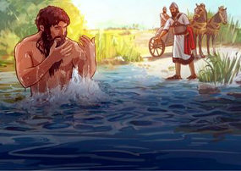
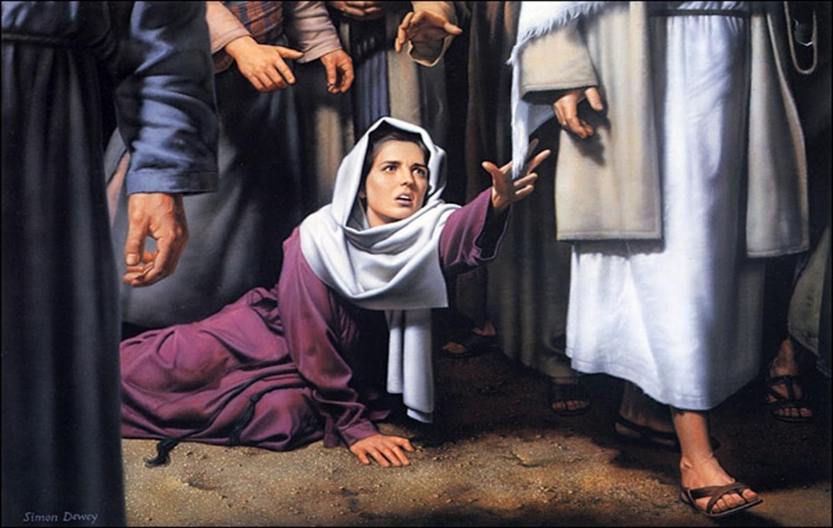
One thought…
2 Kings 5:1-14
Naaman thought that he would be healed in a certain way (v11)
That one thought almost stopped him from receiving his miracle!
Matt 9:20-22
The woman with the issue of blood thought “if only I may touch His garment, I shall be made well.”

Slide 6
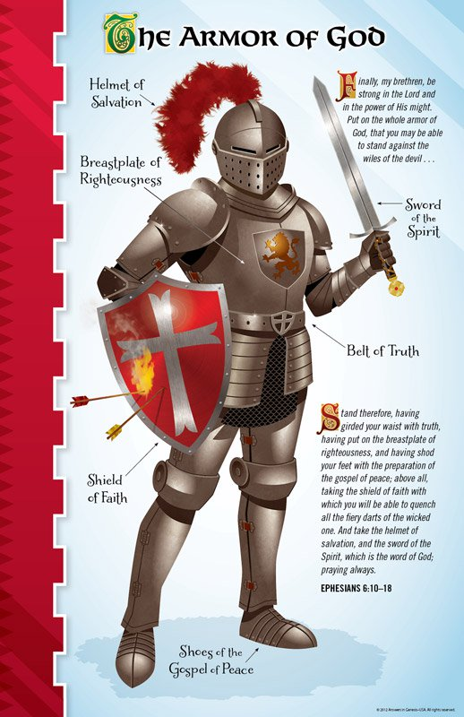
The helmet of salvation
Eph 6:10-18
I must cover my mind with redemptive truth (v17)
Eph 1:3-2:22
1 Pet 1:3-12
Col 1:9-23
Grounded, steadfast, not moved away from the hope of the gospel

Slide 7
How can I be transformed?
RENEW MY MIND:
Recognise the wrong thought
Reject it (Isa 55:6-9, 2 Cor 10:4-5)
I rebuke you!
Shut up!
Get out in Jesus’ Name!
Replace it with God’s thoughts
(Amos 3:3, Phil 4:8, Rom 12:2)
Repeat what God says. It is His voice when I speak His word!
Notes:
So what do I do now?

Slide 8
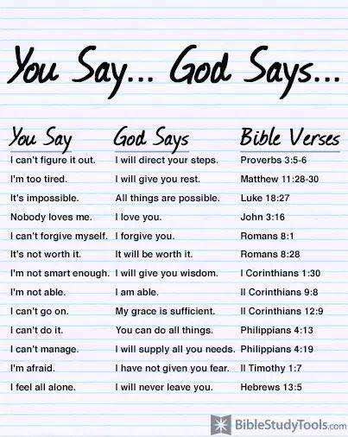
What does God say about me?

Slide 9
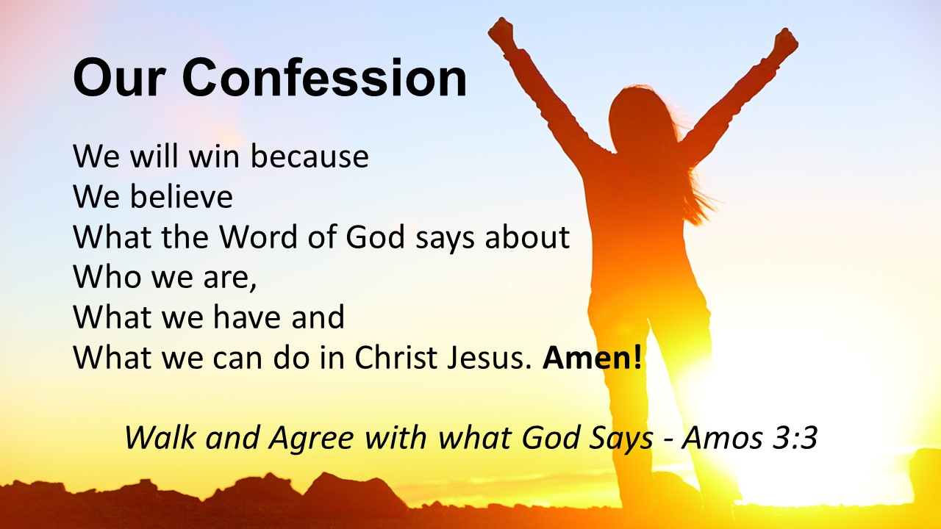
What does God say about us?

Slide 10
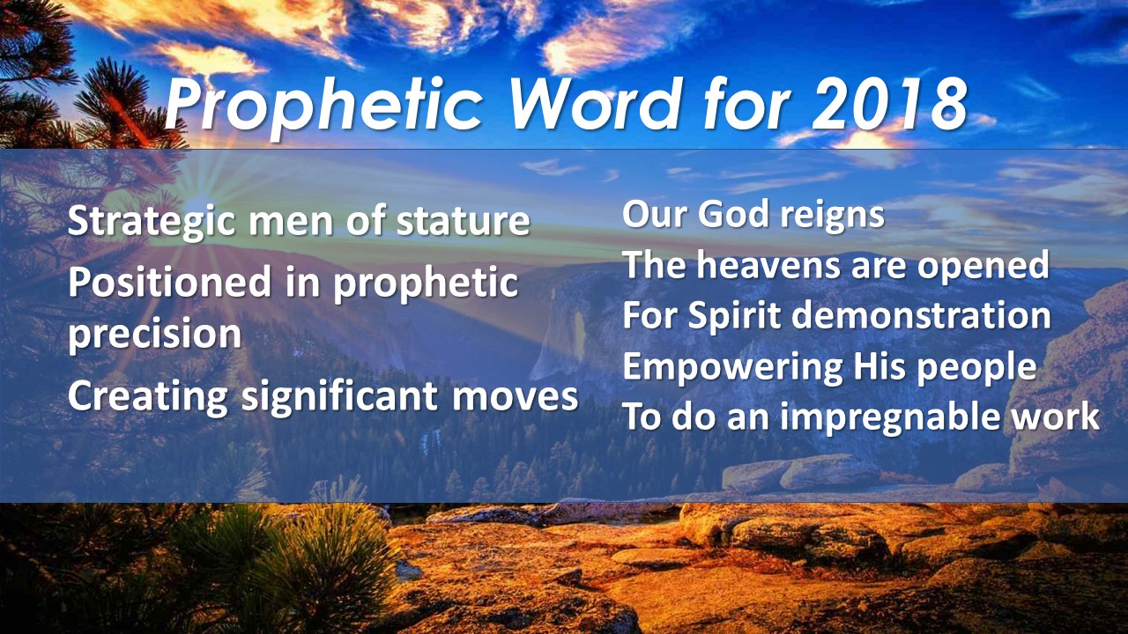
What does God say about us?

